Slide 1

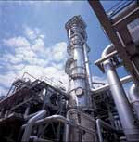
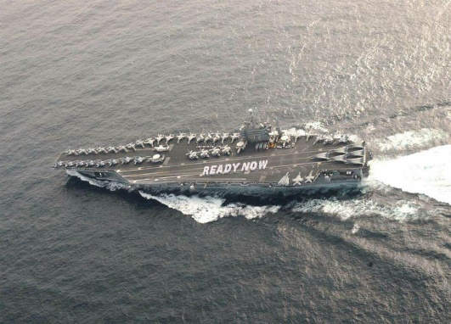
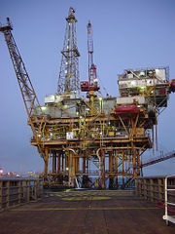


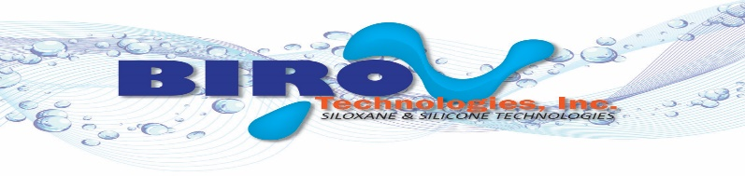

Presentation
SILOXANE TECHNOLOGY

Slide 2
This document describes an ambient-cure epoxy-siloxane system, exhibiting excellent weatherability, corrosion resistance, substrate adhesion, flexibility, and superior chemical and impact resistance after curing.
The chemical combination of Epoxy and Siloxane results in polymers with higher performance characteristics than can be achieved by the physical combination of all polymers. The chemical combination provides the basis for the joined polymeric strength, weathering durability, high temperature properties, and radiation resistance, gloss and color retention and corrosion protective properties of the polymers, whilst overcoming the brittleness of inorganic structures.
Possible substrates include: concrete, cementious products, arhitectural blocks, internal / external pipes, tanks, containers, off-shore oil drilling platforms, metallic framework, bridges, gas turbine engines, heat exchangers, interior / exterior of ships and aerospace equipment.

Slide 3
EPOXY-SILOXANE dual-cure mechanism
  BT Epoxy-Siloxane has the chemical crosslinking via the dual-cure mechanism at room temperature: the nucleophilic opening of the epoxide ring by the amine and the hydrolysis / condensation reaction of the alkoxy groups.
  Nucleophilic opening of the epoxide ring
  The Amine Terminated Silicon are the curing agents whose amine groups react with the resin`s epoxy group

Slide 4
EPOXY-SILOXANE dual-cure mechanism
The alkoxy group of the agent reacts with the silicone resin`s free alkoxy group in the presence of water
Condensation reaction of the alkoxy groups

Slide 5
Epoxy-Siloxane Products
ES-450, EPOXIDE FUNCTIONAL SILICONE RESIN
ES-401, EPOXIDE FUNCTIONAL POLYSILOXANE RESIN
ES-400, EPOXIDE FUNCTIONAL POLYSILOXANE RESIN
ES-300, LMW EPOXIDE FUNCTIONAL POLYSILOXANE RESIN
ES-200, LMW EPOXIDE FUNCTIONAL POLYSILOXANE RESIN
ES-100, LMW EPOXIDE FUNCTIONAL POLYSILOXANE RESIN
ES-50, LMW EPOXIDE FUNCTIONAL POLYSILOXANE RESIN
MOS-41, METHOXY FUNCTIONAL REACTIVE INTERMEDIATE
SH-120, AMINE TERMINATED SILICON RESIN
SH-122, AMINE TERMINATED SILICON RESIN
SH-124, AMINE TERMINATED SILICON RESIN
SH-182, AMINE TERMINATED SILICON RESIN
SAW-175, AMINE TERMINATED SILICON RESIN WITH NFST
SAW-180, AMINE TERMINATED SILICON RESIN WITH NFST
AS-720, METHOXY FUNCTIONAL METHYL-PHENYL POLYSILOXANE
HES-10, EPOXY FUNCTIONAL METHYL HYDROGEN SILICONE RESIN

Slide 6
ES-450
EPOXIDE FUNCTIONAL SILICONE RESIN
Technical information
delivery form liquid
appearance clear to slightly hazy liquid
non-volatile content > 99 %
viscosity at 25 °C approx. 550 mPa s
epoxy equivalent weight approx. 783 g/eq
Suitable hardeners are: reactive amine terminated silicon resin SH-182, SHW-175 and SHW-180
Dilutable by: esters, alcohols and aromatics.
The maximum film thickness should not be more than 6 mils or 150 μm.
Avoid thermal cure or accelerated curing conditions at high temperature.
Special features
excellent corrosion resistance
excellent gloss retention and weather resistance
excellent chemical resistance
suitable for ultra-high solids coatings
anti-graffiti effect
anti-fouling effect
Application
offshore/marine coatings
pipeline coatings
structural steel coatings
tank coatings
concrete walls and floors
antifouling release coatings
All ingredients are listed on the TSCA inventory or comply with the TSCA Polymer Exemption criteria according 40 CFR 723.

Slide 7
ES-401
EPOXIDE FUNCTIONAL POLYSILOXANE RESIN
Technical information
delivery form liquid
appearance clear to slightly hazy liquid
non-volatile content > 99 %
viscosity at 25 °C approx. 724 mPa s
epoxy equivalent weight approx. 480 g/eq
Suitable hardeners are: reactive amine terminated silicon resin SH-124, SH-122 and SH-120
Dilutable by: esters, alcohols and aromatics.
The maximum film thickness should not be more than 5 mils or 125 μm.
Avoid thermal cure or accelerated curing conditions at high temperature.
Special features
excellent corrosion resistance
extraordinary gloss retention and weather resistance
chemical resistance
suitable for ultra-high solids coatings
anti-graffiti effect
Application
offshore/marine coatings
commercial transport coatings
pipeline coatings
structural steel coatings
rail car coatings
tank coatings
anti-graffiti coatings
concrete walls and floors
photocatalytic coatings
All ingredients are listed on the TSCA inventory or comply with the TSCA Polymer Exemption criteria according 40 CFR 723.

Slide 8
ES-400
EPOXIDE FUNCTIONAL POLYSILOXANE RESIN
Technical information
delivery form liquid
appearance clear liquid
non-volatile content > 99 %
viscosity at 25 °C approx. <254 mPa s
epoxy equivalent weight approx. 345 g/eq
Suitable hardeners are: reactive amine terminated silicon resin SH-124, SH-122, SH-120 and SHW-180
Dilutable by: esters, alcohols and aromatics.
The maximum film thickness should not be more than 4 mils or 100 μm.
Avoid thermal cure or accelerated curing conditions at high temperature.
Special features
excellent corrosion resistance
extraordinary gloss retention and weather resistance
chemical resistance
suitable for ultra-high solids coatings
anti-graffiti effect
anti-fouling effect
Application
offshore/marine coatings
commercial transport coatings
pipeline coatings
structural steel coatings
rail car coatings
tank coatings
anti-graffiti coatings
concrete walls and floors
All ingredients are listed on the TSCA inventory or comply with the TSCA Polymer Exemption criteria according 40 CFR 723.

Slide 9
ES-300
LMW EPOXIDE FUNCTIONAL POLYSILOXANE RESIN
Technical information
delivery form liquid
appearance clear to slightly hazy liquid
solventless
viscosity at 25 °C 217 mPa s
epoxy equivalent weight approx. 1152 g/eq
Suitable hardeners are: reactive amine terminated silicon resin SH-182 and SHW-182
Dilutable by: esters, alcohols and aromatics.
The maximum film thickness 3 mils or 75 μm.
Avoid thermal cure or accelerated curing conditions at high temperature.
Special features
Provides faster curing systems 30-45 minutes
Optimizes flexibility, reducing brittleness
Superior chemical resistance
Improved weatherability and heat resistance
Excellent corrosion resistance
Low viscosity
Allows isocyanate free, ambient cure systems
excellent flow characteristics
extraordinary gloss retention and weather resistance
suitable for ultra-high solids coatings
anti-graffiti effect and anti-fouling effect
Application
offshore/marine coatings
commercial transport coatings
pipeline coatings
structural steel coatings
rail car coatings
tank coatings
anti-graffiti coatings
concrete walls and floors
photocatalytic coatings
All ingredients are listed on the TSCA inventory or comply with the TSCA Polymer Exemption criteria according 40 CFR 723.

Slide 10
ES-200
LMW EPOXIDE FUNCTIONAL POLYSILOXANE RESIN
Technical information
delivery form liquid
appearance clear to slightly hazy liquid
solventless
viscosity at 25 °C 7.9 mPa s
epoxy equivalent weight approx. 576 g/eq
Suitable hardeners are: reactive amine terminated silicon resin SH-120, SH-122 and SH-124
Dilutable by: esters, alcohols and aromatics.
The maximum film thickness should not be more than 2 mils or 50 μm.
Avoid thermal cure or accelerated curing conditions at high temperature.
Special features
Provides faster curing systems 75-90 minutes
Optimizes flexibility, reducing brittleness
Superior chemical resistance
Improved weatherability and heat resistance
Excellent corrosion resistance
Low viscosity allows for very low-VOC formulating
Allows isocyanate free, ambient cure systems
excellent flow characteristics
extraordinary gloss retention and weather resistance
suitable for ultra-high solids coatings
anti-graffiti effect
Application
offshore/marine coatings
commercial transport coatings
pipeline coatings
structural steel coatings
rail car coatings
tank coatings
anti-graffiti coatings
concrete walls and floors
photocatalytic coatings
HVAC Coil, heat exchanger and radiator coatings
All ingredients are listed on the TSCA inventory or comply with the TSCA Polymer Exemption criteria according 40 CFR 723.

Slide 11
ES-100
LMW EPOXIDE FUNCTIONAL POLYSILOXANE RESIN
Technical information
delivery form liquid
appearance clear to slightly hazy liquid
solventless
viscosity at 25 °C 5.2 mPa s
epoxy equivalent weight approx. 1160 g/eq
Suitable hardeners are: reactive amine terminated silicon resin SH-120, SH-122, SH-124 and SH-182
Dilutable by: esters, alcohols and aromatics.
The maximum film thickness 1 mils or 25 μm.
Avoid thermal cure or accelerated curing conditions at high temperature.
Special features
Provides faster curing systems 30-45 minutes
Optimizes flexibility, reducing brittleness
Superior chemical resistance
Improved weatherability and heat resistance
Excellent corrosion resistance
Low viscosity
Allows isocyanate free, ambient cure systems
excellent flow characteristics
extraordinary gloss retention and weather resistance
suitable for ultra-high solids coatings
anti-graffiti effect
Application
offshore/marine coatings
commercial transport coatings
pipeline coatings
structural steel coatings
rail car coatings
tank coatings
anti-graffiti coatings
concrete walls and floors
photocatalytic coatings
HVAC Coil, heat exchanger and radiator coatings
All ingredients are listed on the TSCA inventory or comply with the TSCA Polymer Exemption criteria according 40 CFR 723.

Slide 12
ES-50
LMW EPOXIDE FUNCTIONAL POLYSILOXANE RESIN
Technical information
delivery form liquid
appearance clear to slightly hazy liquid
solventless
viscosity at 25 °C approx. 5 mPa s
epoxy equivalent weight approx. 2750 g/eq
Suitable hardeners are: reactive amine terminated silicon resin SH-120, SH-122, SH-124 and SH-182
Dilutable by: esters, alcohols and aromatics.
The maximum film thickness 0.5 mils or 12.5 μm.
Avoid thermal cure or accelerated curing conditions at high temperature.
Special features
Provides faster curing systems 25-30 minutes
Optimizes flexibility, reducing brittleness
Superior chemical resistance
Improved weatherability and heat resistance
Excellent corrosion resistance
Low viscosity
Allows isocyanate free, ambient cure systems
excellent flow characteristics
extraordinary gloss retention and weather resistance
suitable for ultra-high solids coatings
anti-graffiti effect and anti-fouling effect
Application
offshore/marine coatings
commercial transport coatings
pipeline coatings
structural steel coatings
rail car coatings
tank coatings
anti-graffiti coatings
concrete walls and floors
photocatalytic coatings
HVAC Coil, heat exchanger and radiator coatings
All ingredients are listed on the TSCA inventory or comply with the TSCA Polymer Exemption criteria according 40 CFR 723.

Slide 13
MOS-41
Methyl-Phenyl Reactive Silicone Intermediate
Special features
low viscous methoxy-functional methyl-phenyl reactive silicone intermediate
solvent-free
curing at ambient temperature by catalysis and entering of humidity via a hydrolysis-/condensation reaction
very low smoke and odor development of the completely cured coating at temperature load
Technical information
delivery form liquid
appearance yellowish clear liquid
active matter content 100 %
viscosity at 25 °C approx. 7 - mPa s
methoxy content approx. 37 wt-%
Application
high temperature application for industrial facilities, power plants, incinerating plants, ventilators, turbines, silencers, ovens, chimneys, oven inserts, barbeques, electric and gas heaters
anti-corrosion coatings (depending on formulation)
Processing instructions
Use with metallic pigments and special formulations to obtain continuous heat-resistance of up to 600 °C.
For pre-treatment of the surface, sand-blasting is recommended.
Forced drying, e.g., in a convection oven, is only possible in presence of air humidity. The cross-linking proceeds via a hydrolysis/condensation reaction.
The addition of the catalyst KAT-82 must be carried out just before the application
Recommended addition level of the catalyst 3 - 5% calculated on binder
The storage stability of the formulation must be checked.
Recommended dry film thickness: 25 +/- 5 μm

Slide 14
SH-120
AMINE TERMINATED SILICON CURING AGENT
SH-120 is a reactive amine terminated silicone curing agent used as a crosslinker to improve the physical properties and long-term performance of epoxy-siloxane paints and coatings.
PERFORMANCE ADVANTAGES
SPECIAL FEATURES
Typical general characteristics | Inspection Method | Value
Boiling point / Boiling range at 1013 hPa |  | 217 °C
Flash point | ISO 2719 | 93 °C
Density at 25 °C | DIN 51757 | 0,97 g/cm³
Viscosity, dynamic at 25 °C | DIN 51562 | approx. 8-15 mPa.s
Refractive index (25°C) |  | 1,420
Purity |  | 97 %
A.H.E.W. (g/eg) |  | 120
Fast film-drying and cure with liquid epoxy-siloxane polymer Excellent anti-corrosive resistance Excellent adhesion, toughness Excellent water and chemical resistance Low temperature cure Reduces the water absorption Improves initial flexibility, thermal resistance. | Excellent compatibility with epoxy-siloxane resins extraordinary weathering resistance outstanding gloss retention and low yellowing isocyanate-free ambient temperature crosslinking suitable for very high-solids coatings easy-to-clean/anti-grafitti effect free of benzylalcohol/alkylphenols

Slide 15
SH-122
AMINE TERMINATED SILICON CURING AGENT
SH-120 is a reactive amine terminated silicone curing agent used as a crosslinker to improve the physical properties and long-term performance of epoxy-siloxane paints and coatings.
PERFORMANCE ADVANTAGES
SPECIAL FEATURES
Typical general characteristics | Inspection Method | Value
Boiling point / Boiling range at 1013 hPa |  | 217 °C
Flash point | ISO 2719 | 93 °C
Density at 25 °C | DIN 51757 | 0,98 g/cm³
Viscosity, dynamic at 25 °C | DIN 51562 | approx. 8-15 mPa.s
Refractive index (25°C) |  | 1,420
Purity |  | 97 %
A.H.E.W. (g/eg) |  | 122
Fast film-drying and cure with liquid epoxy-siloxane polymer Excellent anti-corrosive resistance Excellent adhesion, toughness Excellent water and chemical resistance Low temperature cure Reduces the water absorption Improves initial flexibility, thermal resistance. | Excellent compatibility with epoxy-siloxane resins extraordinary weathering resistance outstanding gloss retention and low yellowing isocyanate-free ambient temperature crosslinking suitable for very high-solids coatings easy-to-clean/anti-grafitti effect free of benzylalcohol/alkylphenols

Slide 16
SH-124
AMINE TERMINATED SILICON CURING AGENT
SH-124 is a reactive amine terminated silicone curing agent used as a crosslinker to improve the physical properties and long-term performance of epoxy-siloxane paints and coatings.
PERFORMANCE ADVANTAGES
SPECIAL FEATURES
Typical general characteristics | Inspection Method | Value
Boiling point / Boiling range at 1013 hPa |  | 217 °C
Flash point | ISO 2719 | 93 °C
Density at 25 °C | DIN 51757 | 0,96 g/cm³
Viscosity, dynamic at 25 °C | DIN 51562 | approx. 8-15 mPa.s
Refractive index (25°C) |  | 1,420
Purity |  | 97 %
A.H.E.W. (g/eg) |  | 124
Fast film-drying and cure with liquid epoxy-siloxane polymer Excellent anti-corrosive resistance Excellent adhesion, toughness Excellent water and chemical resistance Low temperature cure Reduces the water absorption Improves initial flexibility, thermal resistance. | Excellent compatibility with epoxy-siloxane resins extraordinary weathering resistance outstanding gloss retention and low yellowing isocyanate-free ambient temperature crosslinking suitable for very high-solids coatings easy-to-clean/anti-grafitti effect free of benzylalcohol/alkylphenols

Slide 17
SH-182
AMINE TERMINATED SILICON CURING AGENT
SH-182 is a reactive amine terminated polysiloxane with highly branched carboxylic acid combine in one molecule. This curing agent used as a crosslinker to improve the physical properties and long-term performance of epoxy-siloxane paints and coatings.
PERFORMANCE ADVANTAGES
SPECIAL FEATURES
Typical general characteristics | Inspection Method | Value
Boiling point / Boiling range at 1013 hPa |  | >250 °C
Flash point | ISO 2719 | >130 °C
Density at 25 °C | DIN 51757 | 1,031 g/cm³
Viscosity, dynamic at 25 °C | DIN 51562 | 386 mPa.s
Refractive index (25°C) |  | 1,420
Purity |  | 99 %
A.H.E.W. (g/eg) |  | 183
Fast film-drying and cure with liquid epoxy-siloxane polymer Excellent anti-corrosive resistance Excellent adhesion, toughness Excellent water and chemical resistance Low temperature cure Reduces the water absorption Improves initial flexibility, thermal resistance. | Excellent compatibility with epoxy-siloxane resins extraordinary weathering resistance outstanding gloss retention and low yellowing isocyanate-free ambient temperature crosslinking suitable for very high-solids coatings easy-to-clean/anti-grafitti effect free of benzylalcohol/alkylphenols

Slide 18
SHW-175
AMINE TERMINATED SILICON CURING AGENT WITH NFST.
SHW-175 is a reactive amine terminated silicone curing agent with Nano Fluid Surface Technologies (NFST) used as a crosslinker to improve the antifouling properties and long-term performance of epoxy-siloxane antifouling coatings.
PERFORMANCE ADVANTAGES
SPECIAL FEATURES
Typical general characteristics | Inspection Method | Value
Boiling point / Boiling range at 1013 hPa |  | 217 °C
Flash point | ISO 2719 | 93 °C
Density at 25 °C | DIN 51757 | 0,95 g/cm³
Viscosity, dynamic at 25 °C | DIN 51562 | approx. 380 mPa.s
Refractive index (25°C) |  | 1,420
Purity |  | 97 %
A.H.E.W. (g/eg) |  | 178
Fast film-drying and cure with liquid epoxy-siloxane polymer Excellent anti-corrosive resistance Excellent adhesion, toughness Excellent water and chemical resistance Low temperature cure Reduces the water absorption Improves initial flexibility, thermal resistance. | Excellent compatibility with epoxy-siloxane resins extraordinary weathering resistance outstanding gloss retention and low yellowing isocyanate-free ambient temperature crosslinking suitable for very high-solids coatings easy-to-clean/anti-grafitti effect free of benzylalcohol/alkylphenols

Slide 19
SHW-180
AMINE TERMINATED SILICON CURING AGENT WITH NFST.
SHW-180 is a reactive amine terminated silicone curing agent with Nano Fluid Surface Technologies (NFST) used as a crosslinker to improve the antifouling properties and long-term performance of epoxy-siloxane antifouling coatings.
PERFORMANCE ADVANTAGES
SPECIAL FEATURES
Typical general characteristics | Inspection Method | Value
Boiling point / Boiling range at 1013 hPa |  | 217 °C
Flash point | ISO 2719 | 93 °C
Density at 25 °C | DIN 51757 | 0,95 g/cm³
Viscosity, dynamic at 25 °C | DIN 51562 | approx. 380 mPa.s
Refractive index (25°C) |  | 1,420
Purity |  | 97 %
A.H.E.W. (g/eg) |  | 181
Fast film-drying and cure with liquid epoxy-siloxane polymer Excellent anti-corrosive resistance Excellent adhesion, toughness Excellent water and chemical resistance Low temperature cure Reduces the water absorption Improves initial flexibility, thermal resistance. | Excellent compatibility with epoxy-siloxane resins extraordinary weathering resistance outstanding gloss retention and low yellowing isocyanate-free ambient temperature crosslinking suitable for very high-solids coatings easy-to-clean/anti-grafitti effect free of benzylalcohol/alkylphenols

Slide 20
AS-720
Methyl-Phenyl Polysiloxane Resin
Special features
low viscous methoxy-functional methyl-phenyl silicone resin
solvent-free
curing at ambient temperature by catalysis and entering of humidity via a hydrolysis-/condensation reaction
very low smoke and odor development of the completely cured coating at temperature load
Technical information
delivery form liquid
appearance yellowish clear liquid
active matter content 100 %
viscosity at 25 °C approx. 7 - mPa s
methoxy content approx. 37 wt-%
Application
high temperature application for industrial facilities, power plants, incinerating plants, ventilators, turbines, silencers, ovens, chimneys, oven inserts, barbeques, electric and gas heaters
anti-corrosion coatings (depending on formulation)
Processing instructions
Use with metallic pigments and special formulations to obtain continuous heat-resistance of up to 600 °C.
For pre-treatment of the surface, sand-blasting is recommended.
Forced drying, e.g., in a convection oven, is only possible in presence of air humidity. The cross-linking proceeds via a hydrolysis/condensation reaction.
The addition of the catalyst TnBT must be carried out just before the application (2K system). add in the mill base a water scavenger at an amount of < 0.5%.
Recommended addition level of the catalyst 3 - 5% calculated on binder
The storage stability of the formulation must be checked.
Recommended dry film thickness: 25 +/- 5 μm

Slide 21
HES-10
Epoxy Functional Methyl Hydrogen Polysiloxane Resin
Epoxy Functional Methyl Hydrogen Polysiloxane HES-10 is nontoxic and insipid. As there are fair quantity of relatively active Si-H bonds in the molecule, under the action of catalysts it can react with chemicals containing active groups, such as double bonds or hydroxyl groups.
This product can be converted into film and used to produce a resilient waterproof coating on various materials by using KAT-5050, KAT-6041catalyst at low temperature. It equips itself with outstanding water repellent property which prevents damage due to moisture, as well as mildew and rust development. Besides, its high vapor permeability allows the material to breathe and let water, vapor escape to the outside without causing damage.
Special features
essentially non-toxic
solvent-free
cures to give a durable film
Technical information
delivery form liquid
appearance yellowish clear liquid
active matter content 100 %
viscosity at 25 °C approx. 5 - mPa s
SIH AS H 1.40 -1.75 %
Application
Hydrophobing treatment of hardwood
Treatment for hardwood to make them water repellent
Processing instructions
Suitable catalysts in order of increasing activity include KAT-5050 and KAT-6041
A typical catalyst concentration is 5% to 10%. Concentrations of the more active catalyst must not be increased to the point that bath life becomes too short.
Recommended to dilute with 25-50% Solvent 82 or IPA
The actual curing time will vary with the surface being treated as well as with the catalyst

Slide 22
Epoxy-Siloxane Technology
Improvements achieved with the Epoxy-Siloxane Coating are:
  100% solids
  Optimizes flexibility, reducing brittleness
  high cross linking density
  improved substrate wetting
  reduced effects on health, safety and environment
  significant improved weathering
  outstanding corrosion resistance
  excellent resistance to nuclear radiation
  excellent chemical resistance
  excellent defense against graffiti
  excellent anti-fouling effect
  good heat resistance
  allows isocyanate free, ambient cure systems
  excellent flow characteristics

Slide 23
Epoxy-Siloxane Technology
Factors contributing to cost savings using Epoxy-Siloxane Coatings are:
Application cost saving factors:
  less number of coats
  reduced man-hours
  increased productivity – faster turn around times
  minimized scaffolding
  less disruption to other trades
  reduced coating weight
  reduced waste disposal cost
Performance factors:
  coatings system life extended
Health, Safety and Environmental aspects:
  reduced risk of industrial accidents
  reduction of waste
  reduced VOC emissions
  contains no isocyanates or lead chromates

Slide 24
Detailed Market Information
Applications
  Industrial coatings
  Marine coatings
  Metal corrosion protection for salt and acid environment
  Corrosion thermally stable coatings
  Internal combustion engine coatings
  Car and truck underbody corrosion protection
  Gas turbine engine coatings
  Aircraft applications
  Ice-phobic coatings for wind power blades and aircraft
  HVAC Coil, Heat exchanger and Radiator coatings
  Internal and external pipe line coatings
  anti-fouling applications
  Self-cleaning self-decontaminating and anti-bacterial coatings
  High Voltage Insulator Coating (HVIC)

Slide 25
Detailed Product Information
Nuclear radiation
High energy neutron radiation is present in nuclear reactors, which can lead to degradation processes in the materials of critical components.
Under the effect of neutron bombardment, the substances in Epoxy-Siloxane coating are not converted into radionuclides and has no substances in the matrix which would have an adverse effect on the reactor.
Epoxy-Siloxane Coating is essentially unaffected by nuclear radiation and has an excellent rating for decontamination. The coating performed without any defects on irradiation to a cumulative dose of 5500 megarad as tested.
Organic coating systems show considerably lower decontamination factors with typical values of 500 to 1000.

Slide 26


Slide 27
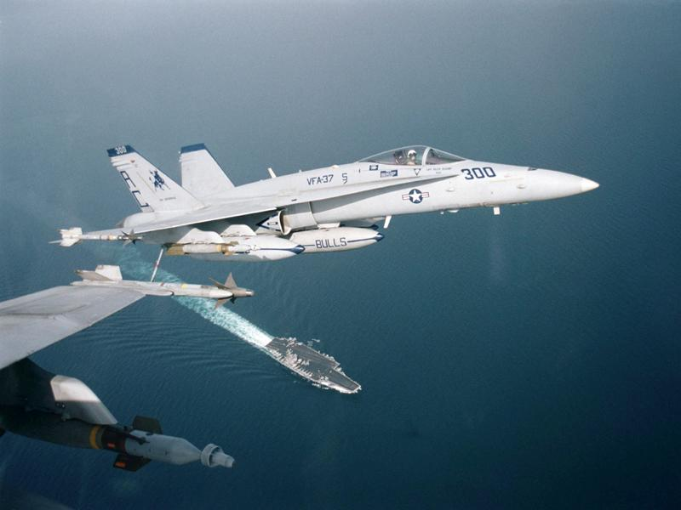

Slide 28
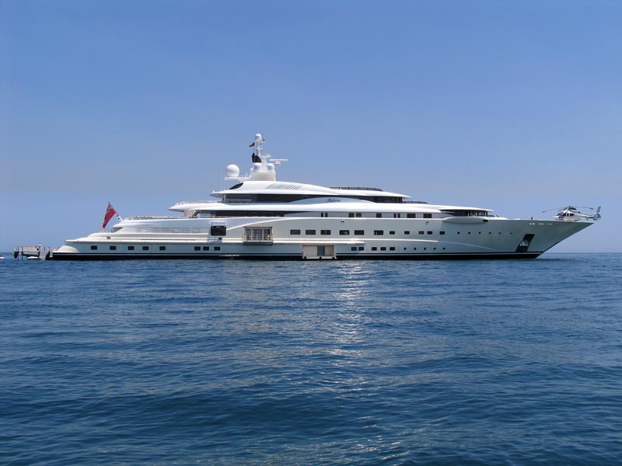
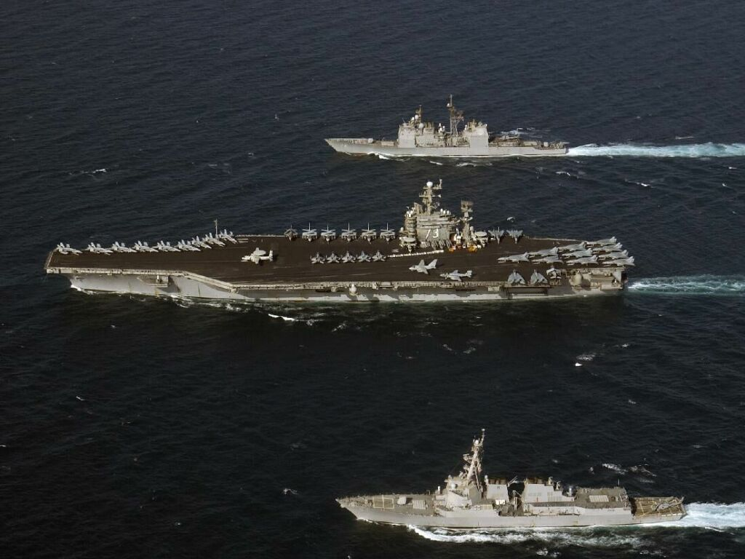

Slide 29
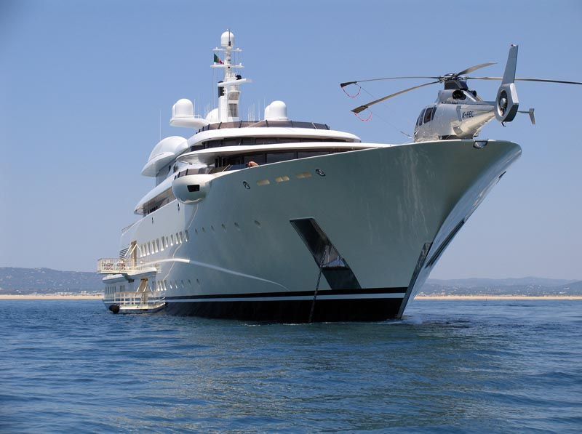

Slide 30
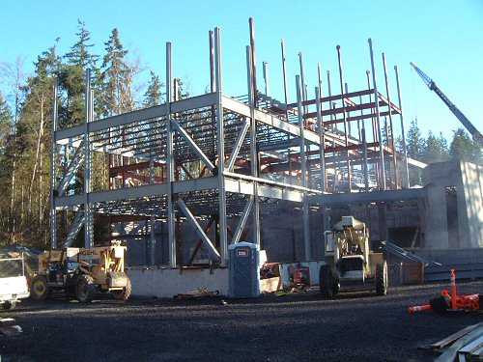

Slide 31
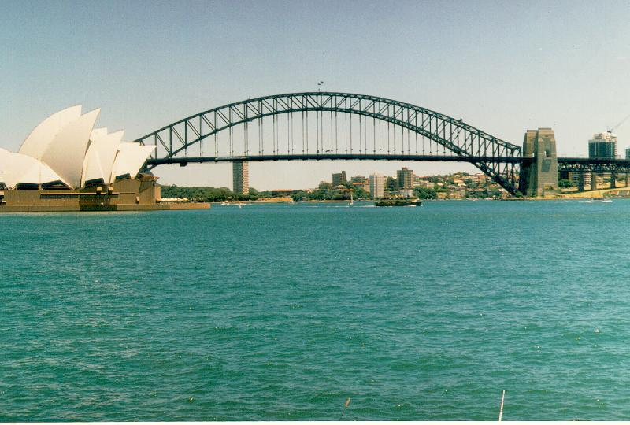

Slide 32
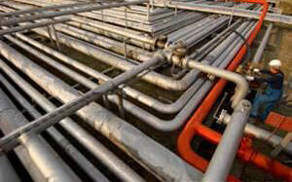
Executive Summary

Slide 33
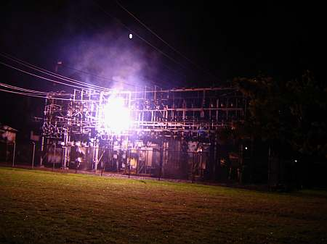

Slide 34

HAVE A GREAT DAY!

